Slide 1
COMP90054 AI Planning for Autonomy Workshop Week7
Ruixi
huor@student.unimelb.edu.au

Slide 2
Objectives
How to compute h^{FF}
IW Algorithm

Slide 3
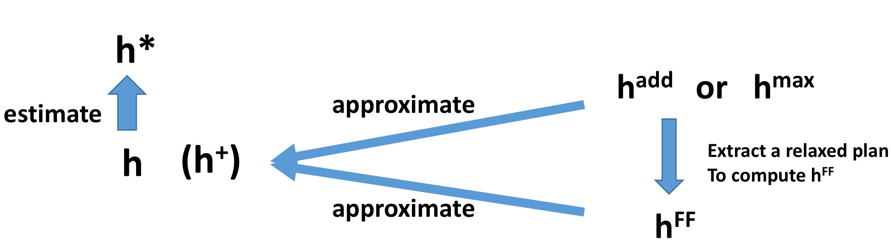
Relationship between h*, h⁺, h^{add}, h^{max}, h^{FF}
h⁺: is the optimal delete relaxation heuristic
But h+ is hard to compute

Slide 4
h^{max} is admissible h^{max} <= h*
but far too optimistic. h^{max} is too small. h^{max} <=h⁺
To sum up, h^{max} <= h⁺ <= h*
h^{add} is not admissible(so h^{add} can be larger than h* in some cases)
It is pessimistic. h^{add} overcounts. h^{add} >= h⁺
The properties of h^{FF} is similar with h^{add}, but h^{FF} won’t overcount

Slide 5
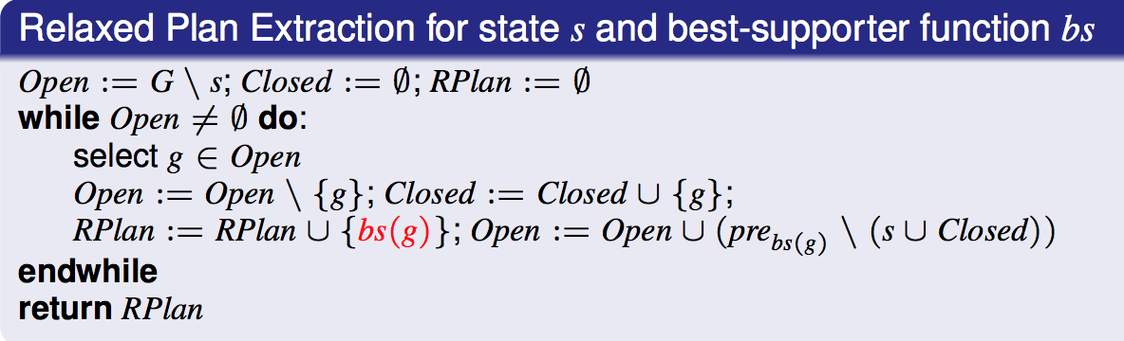
How to compute h^{FF}?
Extract a relaxed plan and then compute h^{FF}
How to extract a relaxed plan?
Step 1: Compute a best-supporter function
Best supporter function bs:
For every fact p ∈ F, an action that is deemed to be the cheapest achiever of p
(within the relaxation)
Step 2: Relaxed Plan Extraction

Slide 6
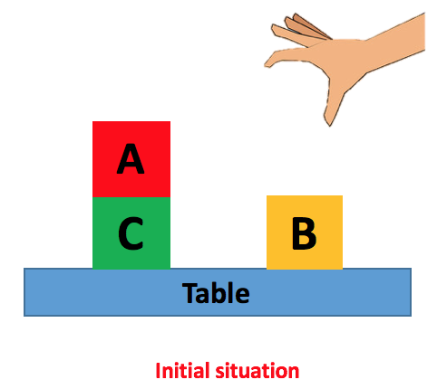
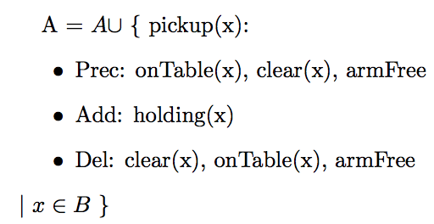
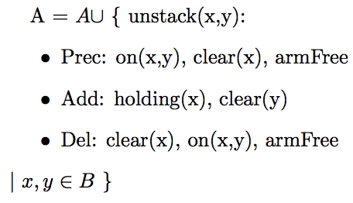
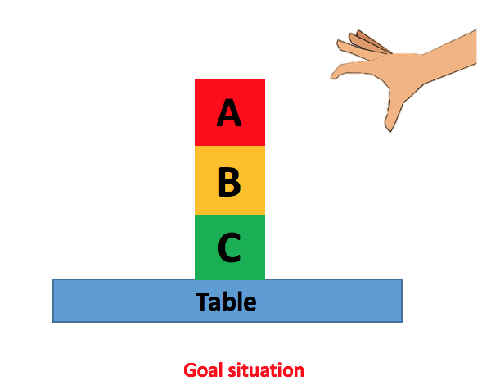
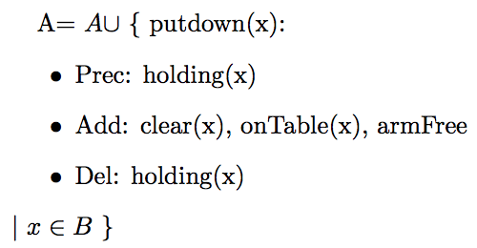
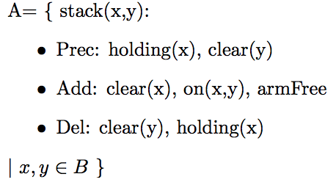
A blocks-world problem – 4 actions

Slide 7
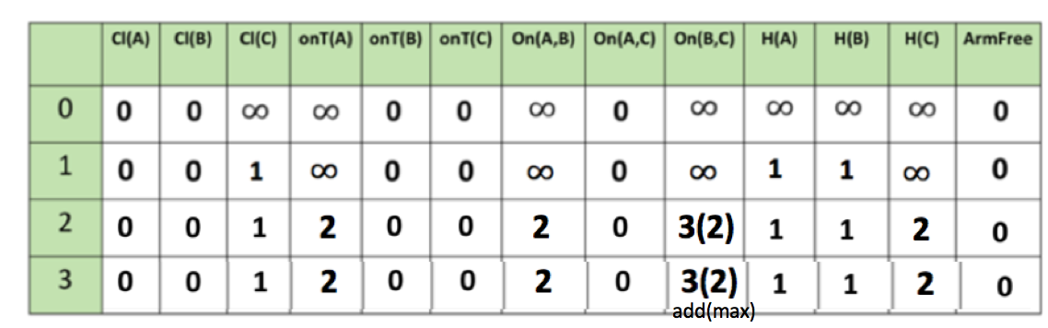
h^{add} or h^{max}
What (one) action can make Cl(C) True?
unstack(A,C), unstack(B,C), putdown(C), stack(C,A), stack(C,B)
Which action is the best supporter function of Cl(C) ?
Cheapest Achiever?

Slide 8
Which action is best supporter function for Cl(C)?
actions
preconditions
hadd
on(A,C)
Clear(A)
ArmFree
0
0
0
unstack(A,C)
1
+
= 1
on(B,C)
Clear(B)
ArmFree
+
3
0
0
= 4
unstack(B,C)
1
+
= 3
putdown(C) 1
holding(C) 2
+
holding(C) 2
Clear(A) 0
= 3
stack(C,A) 1
+
holding(C) 2
Clear(B) 0
= 3
stack(C,B) 1

Slide 9
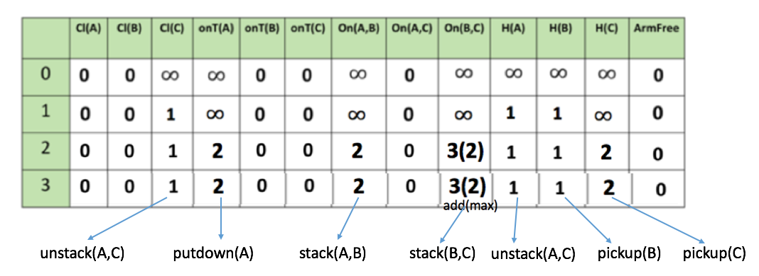
Best Supporter Function for each fact

Slide 10
How to compute h^{FF}?
Extract a relaxed plan and then compute h^{FF}
How to extract a relaxed plan?
Step 1: Compute a best-supporter function
Best supporter function bs:
For every fact p ∈ F, an action that is deemed to be the cheapest achiever of p
(within the relaxation)
Step 2: Relaxed Plan Extraction

Slide 11
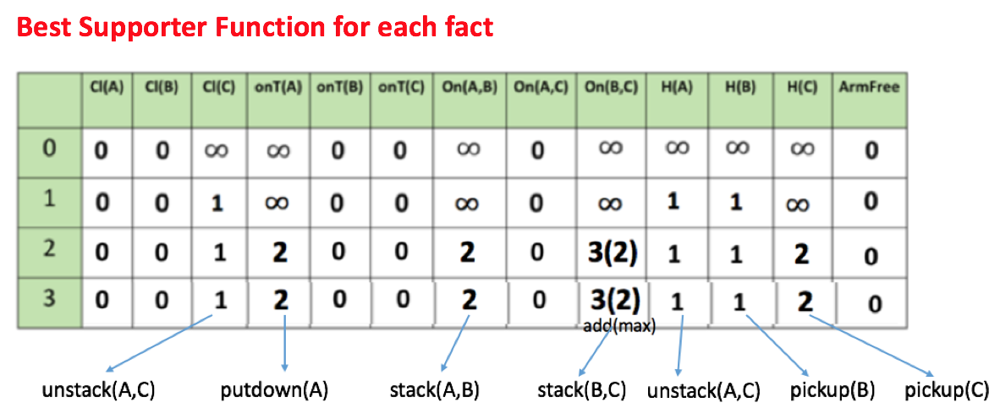


Extract Relaxed Plan
I = {on(A,C), onTable(C), onTable(B), clear(A), clear(B), ArmFree}
G = {on(A,B), on(B,C), onTable(C), clear(A), ArmFree}
Open := G \ I
Open = {on(A,B), on(B,C)}
Closed = $∅$
RPlan= $∅$

Slide 12





Extract Relaxed Plan
I = {on(A,C), onTable(C), onTable(B), clear(A), clear(B), ArmFree}
G = {on(A,B), on(B,C), onTable(C), clear(A), ArmFree}
U is set union operator, so there is no duplicate
Open = {on(A,B), on(B,C)}
Closed = $∅$
RPlan= $∅$
Precondition
bs(on(A,B)) = stack(A,B)
holding(A), clear(B)

Slide 13


Extract Relaxed Plan
I = {on(A,C), onTable(C), onTable(B), clear(A), clear(B), ArmFree}
G = {on(A,B), on(B,C), onTable(C), clear(A), ArmFree}
Open = {on(B,C), holding(A)}
Closed = {on(A,B)}
RPlan= {stack(A,B)}
Precondition
bs(on(B,C)) = stack(B,C)
holding(B), clear(C)

Slide 14


Extract Relaxed Plan
I = {on(A,C), onTable(C), onTable(B), clear(A), clear(B), ArmFree}
G = {on(A,B), on(B,C), onTable(C), clear(A), ArmFree}
Open = {holding(A), holding(B), clear(C)}
Closed = {on(A,B), on(B,C)}
RPlan= {stack(A,B), stack(B,C)}
Precondition
bs(holding(A)) = unstack(A,C)
on(A,C), clear(A), ArmFree
Notes:
All preconditons are already in the initial state, which means we don’t need to apply any action to achieve them.
We didn’t add anything new to openlist. But open list is still not empty.

Slide 15


Extract Relaxed Plan
I = {on(A,C), onTable(C), onTable(B), clear(A), clear(B), ArmFree}
G = {on(A,B), on(B,C), onTable(C), clear(A), ArmFree}
Open = {holding(B), clear(C)}
Closed = {on(A,B), on(B,C), holding(A)}
RPlan= {stack(A,B), stack(B,C), unstack(A,C)}
Precondition
bs(holding(B)) = pickup(B)
onTable(B), clear(B), ArmFree

Slide 16

Extract Relaxed Plan
I = {on(A,C), onTable(C), onTable(B), clear(A), clear(B), ArmFree}
G = {on(A,B), on(B,C), onTable(C), clear(A), ArmFree}
Open = {clear(C)}
Closed = {on(A,B), on(B,C), holding(A), holding(B)}
RPlan= {stack(A,B), stack(B,C), unstack(A,C), pickup(B)}
Precondition
Rplan = {stack(A,B), stack(B,C), unstack(A,C), pickup(B)}
bs(clear(C)) = unstack(A,C)
on(A,C), clear(A), ArmFree

Slide 17
Rplan = {stack(A,B), stack(B,C), unstack(A,C), pickup(B)}
How to get h^{FF} from Relaxed Plan?
Sum up the cost of actions in relaxed plan
h^{FF} = 4
for both hadd and hmax
Even hadd and hmax for some fact is different, but best supporter function for that fact are the same in this example.
So h^{FF} = 4 for both h^{add} and h^{max}

Slide 18
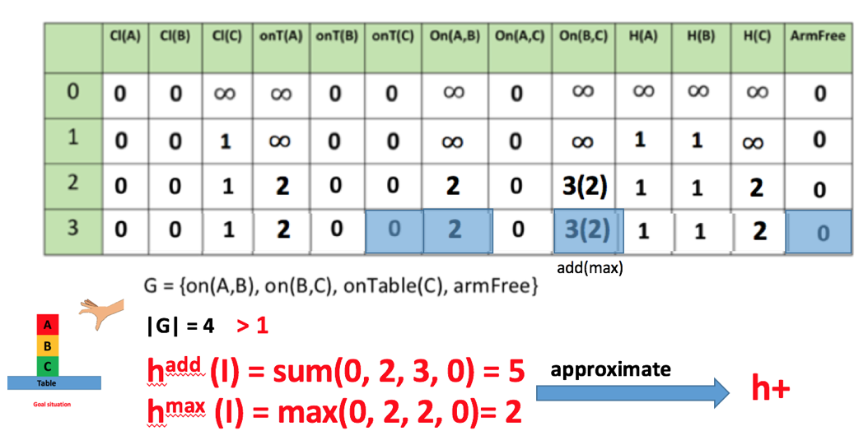
h^{FF} = 4
for both hadd and hmax

Slide 19
Relationship between h*, h⁺, h^{add}, h^{max}, h^{FF}
h⁺: is the optimal delete relaxation heuristic
But h+ is hard to compute

Slide 20
Execution of IW Algorithm
(Blind Search)

Slide 21
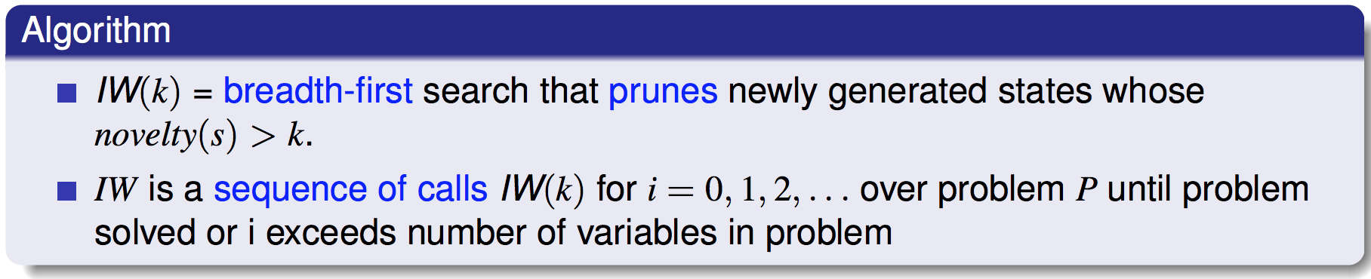
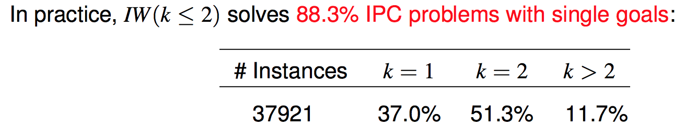
IW (Iterated Width)
Blind Search Algorithm

Slide 22
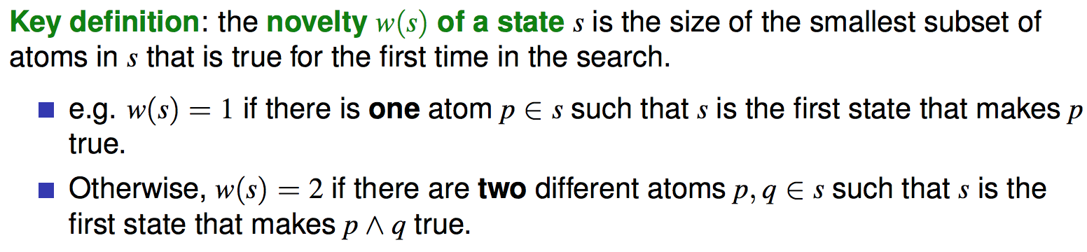
Novelty

Slide 23

How to compute novelty of a state?
A | B | C | D
{B, C}
New things
Novelty
iw(1)
C
1
(A,B) | (A,C) | (A,D) | (B,C) | (B,D) | (C,D)
iw(2)
C
(B,C)
1

Slide 24
How to compute novelty of a state?
A | B | C | D
{A,D}
New things
Novelty
iw(1)
A
1
D
(A,B) | (A,C) | (A,D) | (B,C) | (B,D) | (C,D)
A
iw(2)
D
1
(A,D)
(A,B)
(B,D)

Slide 25
How to compute novelty of a state?
A | B | C | D
{A,B}
New things
Novelty
iw(1)
Empty
|F| = 4
(A,B) | (A,C) | (A,D) | (B,C) | (B,D) | (C,D)
iw(2)
(A,B)
2

Slide 26
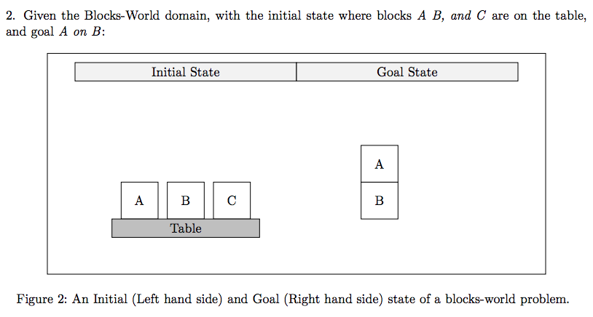

Slide 27
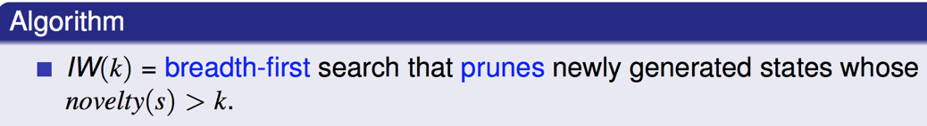

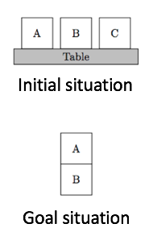
IW(1) process
Initial state: {onTable(A), onTable(B), onTable(C), clear(A), clear(B), clear(C), ArmFree}
Goal state: {on(A,B)}
onT(A) | onT(B) | onT(C) | Cl(A) | Cl(B) | Cl(C) | H(A) | H(B) | H(C) | On(A,B) | On(B,A) | On(A,C) | On(C,A) | On(B,C) | On(C,B) | AF
H(C)
1
Pickup(C)
Initial state
H(B)
Pickup(B)
1
Pickup(A)
H(A)
1

Slide 28
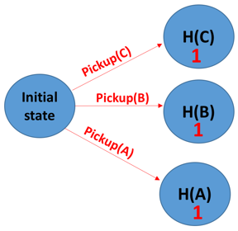
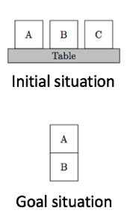
IW(1) process
On(C,A)
1
Stack(C,A)
Stack(C,B)
On(C,B)
1
Putdown(C)
Prune
|F|
> 1

Slide 29
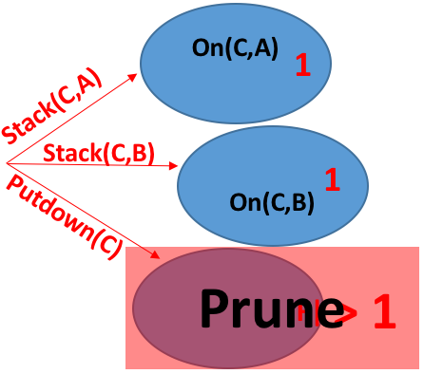
IW(1) process
On(B,A)
1
Stack(B,A)
Stack(B,C)
On(B,C)
1
Putdown(B)
Prune
|F|>1

Slide 30
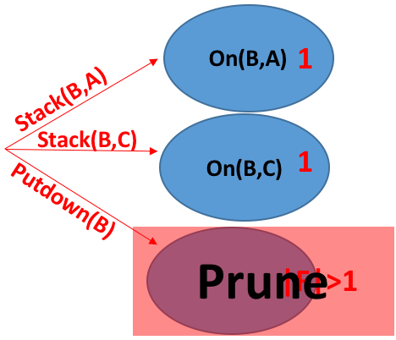
IW(1) process
Achieve Goal
On(A,B)
1
Stack(A,B)
Stack(A,C)
Plan found by IW:
pickup(A), stack(A,B)
Putdown(A)
Optimal

Slide 31
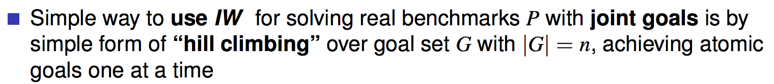
IW (Iterated Width)
If we have single goal, then the plan found by IW is optimal
What if we have more than one goal?
SIW (Serialized Iterated Width)
SIW can not guarantee optimal

Slide 32
A
C
A
B
B
Table
Initial situation
Goal situation

Slide 33
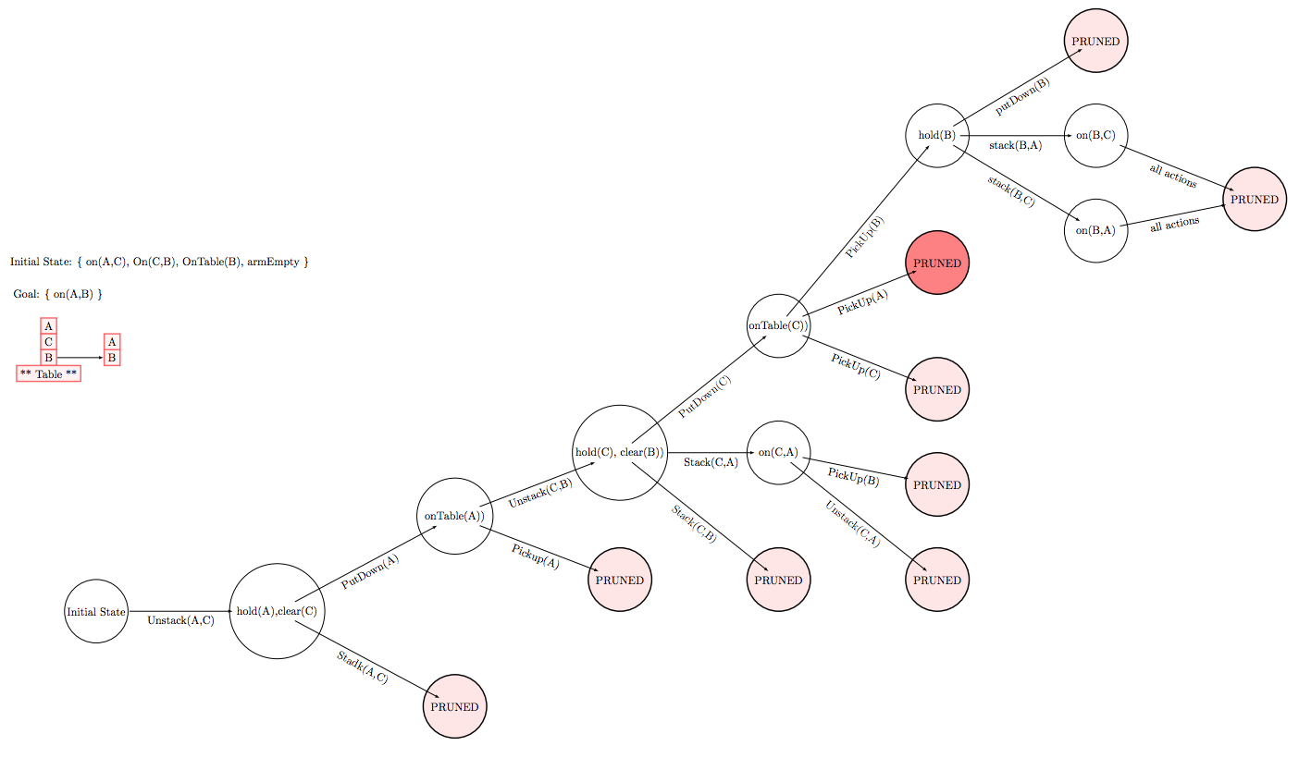
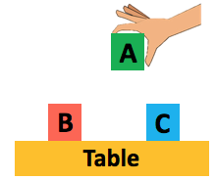
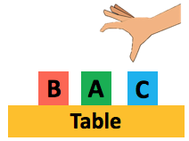
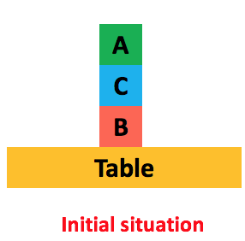
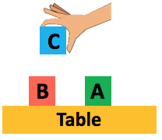
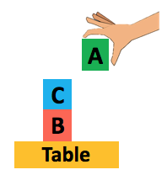
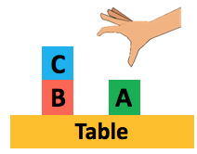
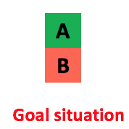
IW(1) process
holding(A)
Then try IW(2), we achieved our goal
holding(A)
Clear(C)

Slide 34
Comparison
IW
BFS
Heuristic Search Algorithms
IW is blind search algorithm, compared with heuristic search, IW doesn’t need additional information about problem
IW is quicker than BFS, because we reduce the number of expansion nodes by pruning with the help of novelty.

